Slide 1



FUDAN MICRO
MCU Product Line Introduction
FUDAN MICROELECTRONICS GROUP
A professional company engaged in the design, development and provision of system solutions for very large scale integrated circuits

Slide 2

Group profile
competitiveness
MCU Product line
culture

Slide 3


Group Profile

Slide 4




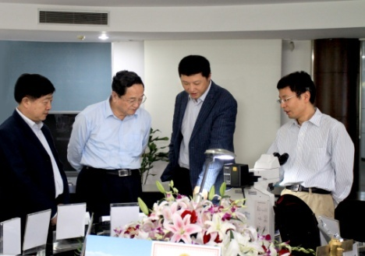

About Us
Shanghai Fudan Microelectronics Group is a professional company engaged in the design, development, and testing of very large-scale integrated circuits, and provides system solutions to customers.
In July 1998, Fudan Microelectronics was founded by the "State Key Laboratory of Application-Specific Integrated Circuits and Systems" of Fudan University, Shanghai Commercial Investment Company and a group of entrepreneurs who dreamed of creating China's best integrated circuit design company.
Design
VLSI
Development
Solution

Slide 5


Milestone
Sales (millions of yuan)
2022
2021
Controlled subsidiary Hualing Corporation
Listed on BSE in October
2014
Listed on SSE in August
securities code: 430139.BJ
2000
Listed on the HKEX
on January 8
securities code: 688385.SH
1998
Listed on Hong Kong GEM
in August
stock code: 01385.HK
Established on July 16
The first listed company in the
domestic integrated circuit design industry
The first domestic
joint-stock integrated
circuit design enterprise
Beginning
Annual sales exceed 100 million yuan
Annual sales exceed 1 billion yuan
Annual sales exceed
3.5 billion yuan

Slide 6

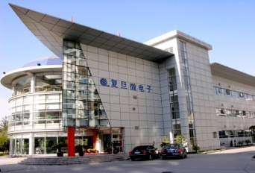







Company Employees & Locations
2000⁺
Full time employees
Nearly 1200 R&D，more than half of the total number of employees
production tester
7⁺
Offices worldwide
Managers
R&D
Less than 5 years of work experience
Over 5 years of working experience
Shenzhen Office
Shanghai headquarters
Hong Kong-based company
Beijing Office
Singapore Office
America-based company
Taiwan Office

Slide 7








Group Product Lines
Security
MCU
Smart IC card, RFID/READER chip cumulative shipments exceed 10 billion units
Security and NFC reader chip used in vehicles
MCU mass production for more than 20 years
Cumulative shipments exceed 900 million units
Market-leading in the cumulative shipments of
Low-power, Industrial MCU
ISO26262:2018 Certification passed
IEC60730 Class B Certification passed
Smart appliances
Market share exceeds 50%
The most advantageous supplier in China
New energy electric vehicle charging piles are widely used
NVM
Leading domestic manufacturers in EEPROM industrial market share
Support Automotive Grade 1/2/3
FPGA
Take the lead in developing China’s first billion-gate level FPGA

Slide 8

competitiveness

Slide 9
Competitiveness
Complete
system process
ISO9001 QMS
  IECQ QC080000 HSPM System
  ISO 14064-1 GHG Management System
  ISO 26262:2018 Automotive Functional Safety Process Certification
  IEC60730 Class B Certification
Design & Engineering experience
Billions of chips are shipped annually
Independent Engineering Implementation
Rich capabilities in chip design and experiences in product commercialization
Technical background
Originating from the "State Key Laboratory of ASIC and Systems" at Fudan University
Postdoctoral Research Station
Testing and Analysis Capabilities
Complete capabilities in YA、FA
Autonomous and controllable test development capabilities
Supply chain assurance
Long-term cooperative relationships with mainstream international and domestic processing manufacturers
Dual supply strategy

Slide 10



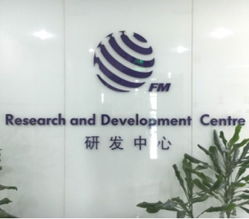


R&D System
We have a complete R & D system, enabling us to
offer a wider range of services.
Academia Sinica
Chip R & D Center
Engineering Implementation Organization
Postdoctoral Research Station

Slide 11

R&D System
Supported by advanced process technologies,
we have a complete chip development process
…
28/22nm
65/55nm
0.13um
/90nm
0.18um
0.35um
0.6um
0.8um

Slide 12
















Upstream Partners

Slide 13
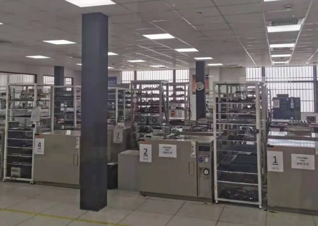
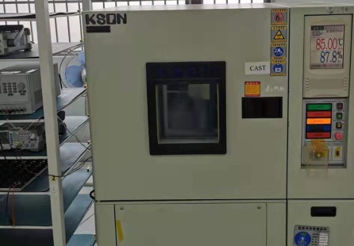

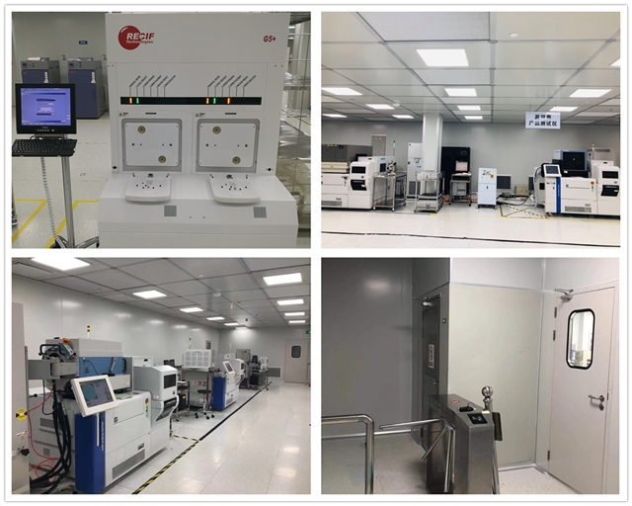
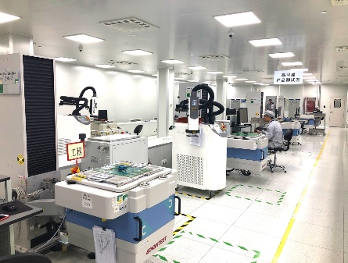



Reliability Assurance
In-house reliability laboratory
Complete assessment criteria
Third-party
CNAS Laboratory
test equipment
Multiple Testing Equipment
constant temperature and humidity tester
temperature cycling chamber
thermal shock testing equipment
ESD、Lu equipment
Class-1000 Cleanroom
Wafer Testing Workshop
Finished Product
Testing Workshop
Testing Supplier
Advanced testing technologies and equipment
Mass Production Testing Services - Shanghai Hualing
High-performance
ATE
test equipment
Advantest V93000、T5830
Teradyne J750
CREDENCE PK2
TSK UF3000EX

Slide 14
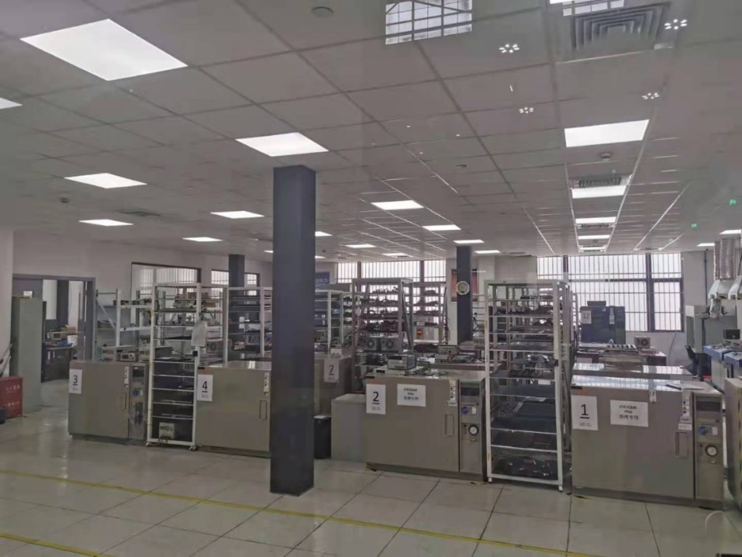
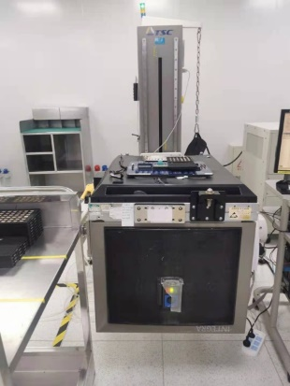
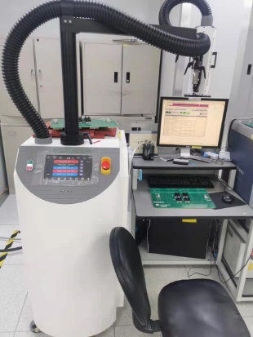
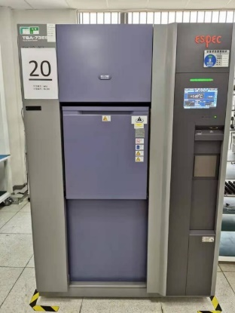
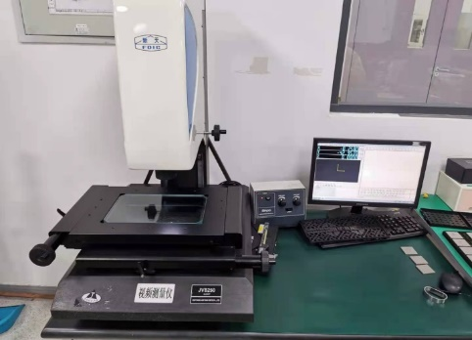
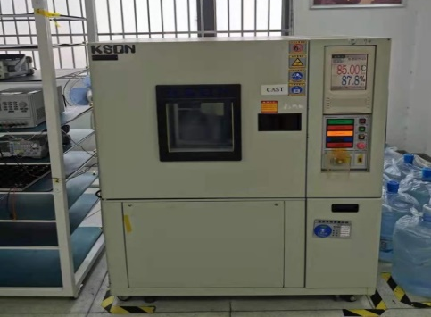
In-House Reliability Laboratory
The reliability laboratory (Jiangnan 99 Park)
covers an area of ​​about 300 square meters.
There are 37 main test equipments, including:
16 high-temperature chambers
1 temperature circulation chamber (including 1 air compressor)
3 high-temperature and high-humidity chambers
1 weldability and welding operating platform
1 shear force tester
1 chemical cabinet
1 nitrogen cabinet
2 ESD and LU equipment
2 appearance inspection and testing instruments.

Slide 15

MCU PRODUCT LINE

Slide 16
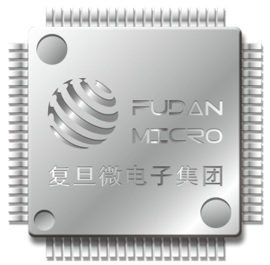
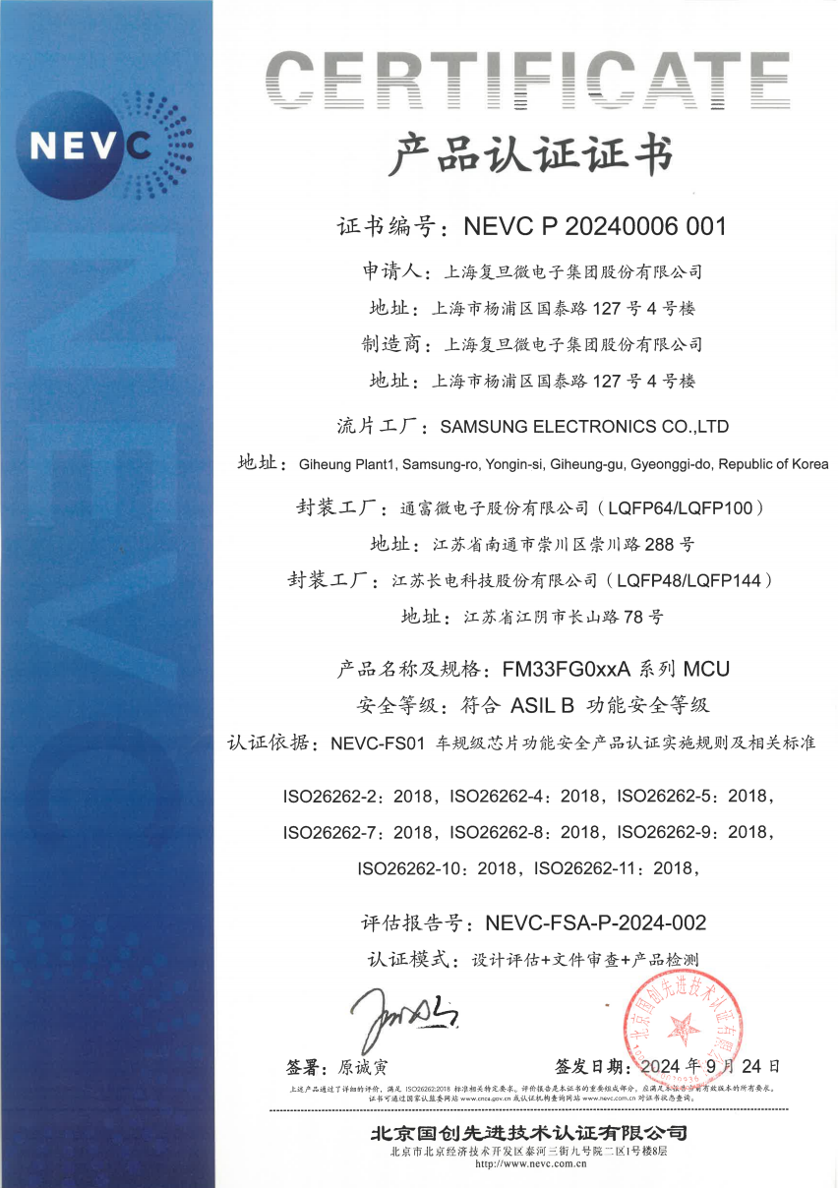
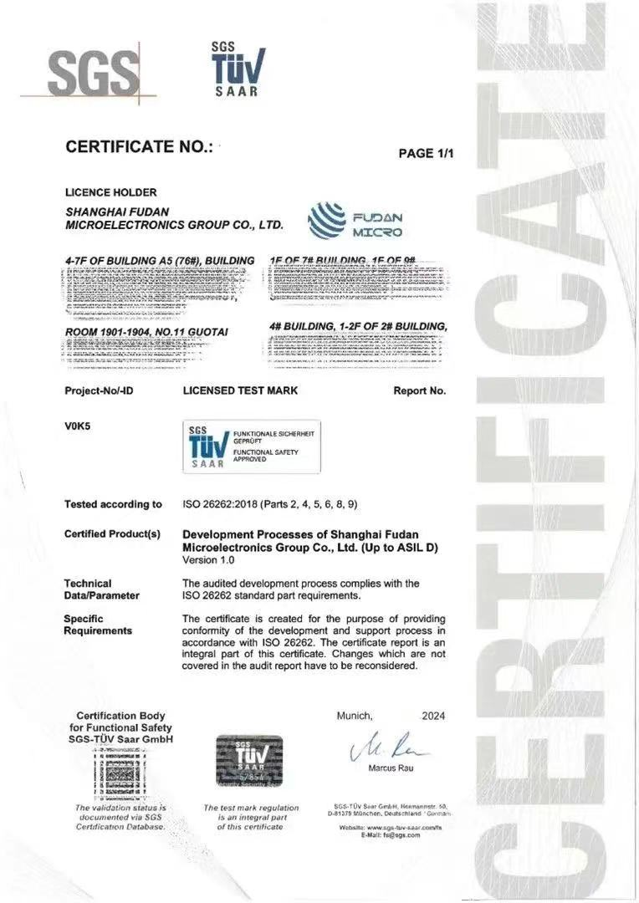
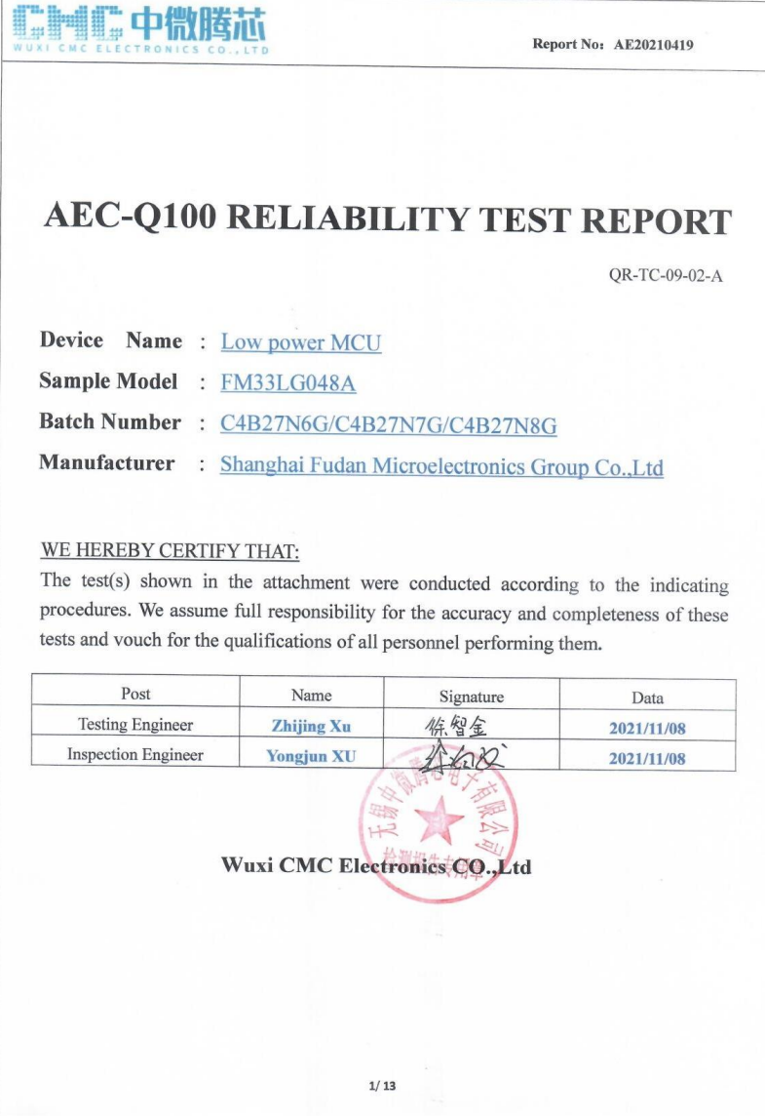
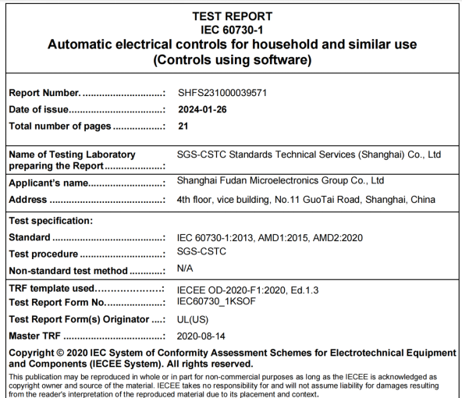
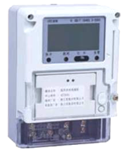
MCU Product Line
2021
The first automotive
MCU product has
passed the
functional safety
ASIL B certification
The first MCU chip passed the AEC - Q100 assessment
has entered mass production
2004
over 900
million pieces
ISO 26262:2018
ASIL D certification
Business Division
established
Lead Low-power, Industrial MCU’s cumulative shipments in China
mass production of MCUs has been ongoing for
over twenty years
2024
Started with MCU for Smart Meters
Operating stably in the field for over a decade
More than twenty years of high-reliability MCU design experience, we have comprehensively laid out MCU applications in home appliances, industrial, and automotive fields.
Over 120+ people
2023
encompasses Chip Design, Hardware, Software,
Testing, Sales, etc
IEC60730 Class B
Certification passed

Slide 17

MCU Development History
Cumulative shipments
have exceeded
20 series and over a hundred models in mass production for industrial regulations
4 series and more than 20 models in
mass production for automotive regulations
2024
Launched the FM33LR0/FM33FH0/FM33FG5 (M-STAR)/FM33HG0 series of MCUs
2023
Launched the FM33LF0/FM33FG0/FM33FK5(M - STAR) series of MCUs
900
2022
Launched the FM33LE0/FM33FT0 series and FM33A0XXEVB series of MCUs
million
2021
Launched the FM33FR0 series of MCUs, and FM33LG0xxA has passed the automotive regulation certification
2020
Launched the FM33LG0 and FM33A0xxEV series of MCUs
2019
Launched the FM33L0, FM33LC0, and FM33M0 series of MCUs
2017-2018
Launched the FM33A0xx and FM33G0xx series of MCUs
ARM Core
2016
Launched the FM3316 series of LP MCUs, with cumulative shipments reaching tens of millions
20y+
product experience
2000-2015
Successively launched the FM23xx/FM3308/FM3318 series of MCUs, cumulative shipments
has reached hundreds of millions
10y+
stable operation
the 1990s
Began the research and development of MCU products and carried out technical accumulation
10y+
Low-Power research

Slide 18


MCU Application Field
Public Utilities
White
Goods
Fudan Micro
MCU
Industrial
Automotive

Slide 19
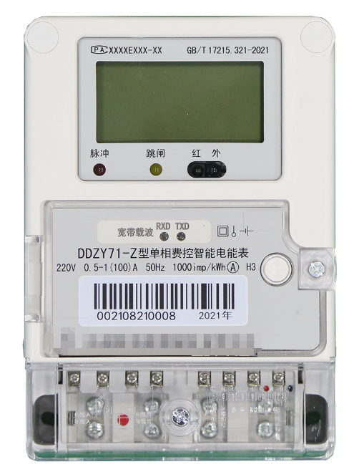
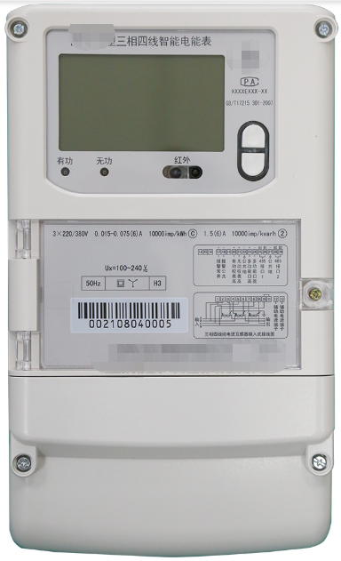
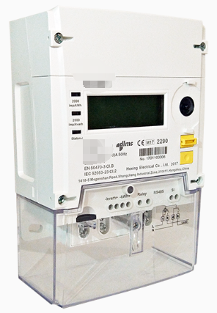
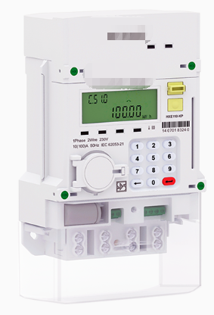

MCU & Metering Solutions in Power Meter Field
Chinese
power meters
State Grid single-phase/three-phase Solutions
China Southern Power Grid single-phase/three-phase Solutions
overseas
power meters
CIU/Rail-mounted meters/STS meters, etc
Single–phase/Three-phase
intelligent power meters
Solution Support Services
Technical Support for MCU Solutions
Technical support for metering solutions
Digital display meters/Rail - mounted meters, etc.
Intelligent power meters with metering System-on-Chip (SOC)
…
…
…
communication module

Slide 20






Application Field - Public Utilities (Power Meter)
The market share of State Grid's single-phase meters
has maintained steadily at around 65%
partner

Slide 21
Power Meter MCU Roadmap
Flash(KB)
Developing
Sample
Mass Production
FM33FP5xx Series
ARM-China STAR, 160MHz
1M FLASH(ECC), 256K RAM(ECC)
LQFP100/144/176
Dual SAR ADC, DAC
ECC512, SHA512
Fusing Protection, Application Code Protection
MG33M0xxER Series
Cortex-M0,48MHz
512K FLASH, 64K RAM
LQFP64/100
ECC512，SHA256，LCD Booster
Fuse Protection、Application Code Protection
dynamic range of 5000:1 has an error of less than 0.1%.
Three independent metering channels
Zero-line-dropout metering/DC metering/Zero-crossing detection
31st harmonic, wave-following sampling
SOC
1024
FM33A0xxEH Series
Cortex-M0,48MHz
512K FLASH, 96K RAM
LQFP48/64/80/100
CAN
ECC512，SHA256
LCD Booster
Fusing Protection, Application Code Protection
FM33A0xxEV Series
Cortex-M0,64MHz
512K FLASH, 80K RAM
LQFP48/64/80/100
ECC512，SHA256
LCD Booster
Fuse Protection、Application Code Protection
FM33A0xx Series
Cortex-M0,24MHz
512k FLASH, 64K RAM
LQFP48/64/80/100
512
FM33A5xx Series
ARM-China STAR
512K FLASH(ECC), 48K RAM
LQFP48/64/80/100
IPTIM*8、DMA*11、QSPI
MG33M0xxERB系列
Cortex-M0,49MHz
256K FLASH, 16K RAM
LQFP48/64/80/100
Fusing Protection, Application Code Protection
he dynamic range error of 5000:1 is less than 0.1%.
Three independent metering channels
Zero-line-loss metering/DC metering/Zero-crossing detection
FM33A0xxB Series
Cortex-M0,24MHz
256k FLASH, 24K RAM
LQFP48/64/80
SOC
FM33A0xxEVB Series
Cortex-M0,48MHz
256/512K FLASH, 48K RAM
LQFP48/64/80/100
ECC512
IPTIM
Fuse Protection、Application Code Protection
FM33A0xxD Series
Cortex-M0,36MHz
256k FLASH, 32K RAM
LQFP48/64/80
Three - phase metering chip
Single - phase metering chip
256
128
FM33LE0xx Series
Cortex-M0, 64MHz
128K FLASH, 16K RAM
LQFP48/64、QFN32
时间
~2023
2024
2025

Slide 22
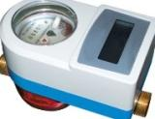
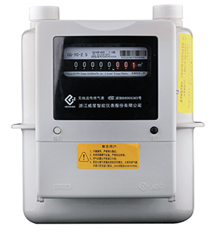
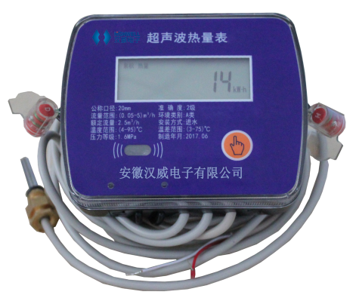







Application Field - Public Utilities (Water/Heat/Gas Meters)
The market share of water, gas and heat meters exceeds 40%
Card, Bluetooth, NB, Lora, Remote transmission
Water Meter
Reed switch/Hall pulse, Photoelectric direct reading, Non-magnetic, Ultrasonic wave
Gas
Meter
Card, NB, Lora, Remote transmission
Smart
Reed switch/Hall pulse, Photoelectric direct reading,
Non-magnetic, Ultrasonic wave
Heat
Meter
Mbus、 Remote transmission
Reed switch/Hall pulse , Ultrasonic wave
Partner

Slide 23




























Application Field – White Goods
家电客户
Air conditioner
Refrigerator
Washing machine
Segmented market
Partner
Wired controller
Remote control
Integrated stove
Cigarette machine
Dishwasher
Water heater
Smart toilet
Water purifier

Slide 24
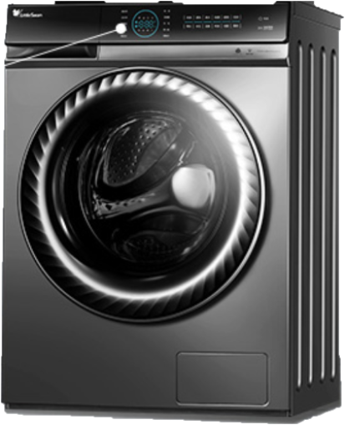
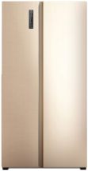
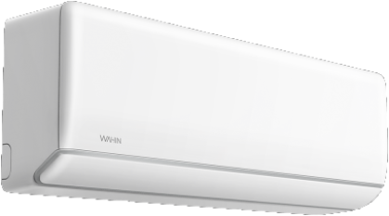
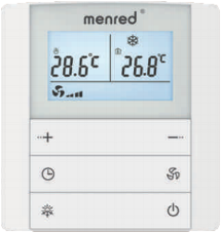
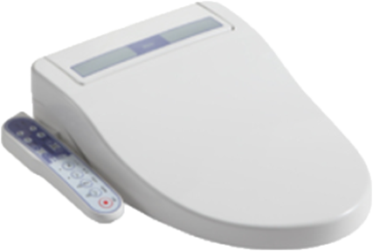
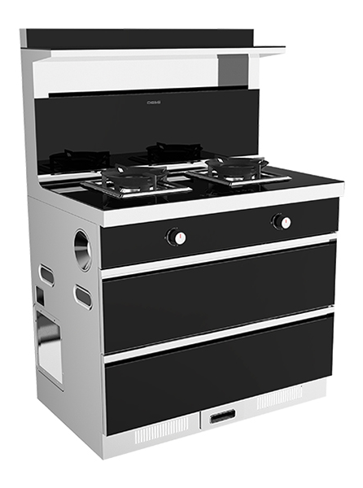
Application Field – White Goods
Frequency Conversion
家电客户
Display
Master Control
Display control panel
Touchpad
Master control board
Variable Frequency Drive
for Ice Pressor
Display control panel
Touchpad
Master control board
Variable Frequency Drive for Motor
Display control panel
Touchpad
Indoor unit
Master control board
Variable Frequency Drive for Indoor Unit
Variable Frequency Drive for Air Compressor
Dual variable frequency for outdoor unit
Temperature control panel
Kitchen and bathroom appliance master board
Variable Frequency Drive for Fans (Household, Industrial)

Slide 25

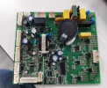
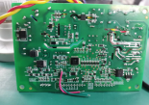
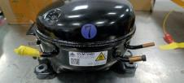
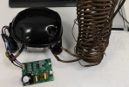




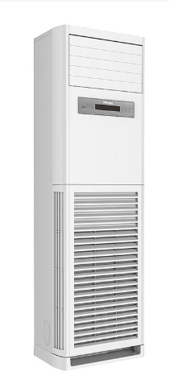
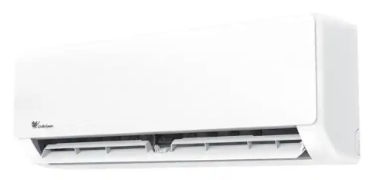
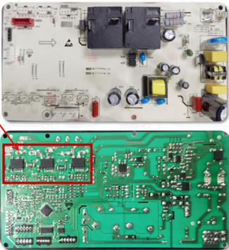
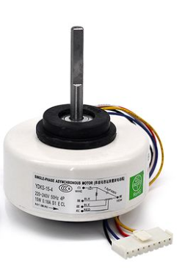




Application Field – White Goods
Inverter motor drive scheme
inverter refrigerator compressor
inverter refrigerator compressor
inverter refrigerator compressor
Algorithm Scheme Features
Non-inductive startup algorithm
Single resistance sampling; Reconstruct three-phase current
Current loop, Speed loop PI control
Senseless observer, Estimate the motor position accurately
Weak magnetic control
Support Tailwind Start、Headwind Start
Support Constant Blowing Rate Control
Multiple Protective measures: Overcurrent, Phase loss, Overvoltage,, Undervoltage, Overload, Overtemperature, Blocking etc
COOPERATION CASE
Household Indoor Unit Integrated Main-Transformer Board
Household Indoor Unit Integrated Main-Transformer Board
Household Indoor Unit Integrated Main-Transformer Board
Household Inverter

Slide 26
White Goods MCU Roadmap
Flash(KB)
Developing
Sample
Mass Production
FM33FH5xx Series
ARM-China STAR, 200MHz
Upto 1M FLASH, 256K RAM
48/64/80/100Pin
5Msps ADC, DAC
USB/USART/SDIO/TSI/TFT-LCD
512
FM33FG0xx Series
Cortex-M0, 64MHz
Upto 512K FLASH, 64K RAM
48/64/100/144Pin
12Bit SAR ADC, COMP, DAC
CANFD/LIN/SPI/IIC/USART /SENT
FM33FX5xx Series
ARM-China STAR, 200MHz
Upto 512K FLASH, 64K RAM
64/80/100Pin
12bit ADC, DAC,OPA,COMP
CAN/QSPI/I2C/USART/DSP/FPU
384
FM33FR0xx Series
Cortex-M0, 48MHzUpto 384K FLASH, 32K RAM
32/64/100Pin, 12Bit SAR ADC
CAN/LIN/SPI/IIC/USART/TSI
FM33FH0xx Series
Cortex-M0, 72MHz
Upto 384K FLASH, 32K RAM
32/48/64/80/100Pin
12bit ADC, DAC
CAN/SENT/QSPI/I2C/USART/TSI
256
FM33FK5xx系列
ARM-China STAR , 80MHz
Upto 256K FLASH, 48K RAM
32/48/64/100
12Bit SAR ADC, COMP, DAC
CANFD/LIN/QSPI/IIC/USART /USB
FM33LD5xx Series
ARM-China STAR , 168MHz
Upto 256K FLASH, 48K RAM
48/64/80/100
12Bit SAR ADC, COMP, DAC
CAN/LIN/QSPI/IIC/USART/Cordic/DSP/FPU
FM33LC0xx Series
Cortex-M0, 64MHz
Upto 256K FLASH, 24K RAM
32/48/64Pin
12Bit SAR ADC, OPA, USB
128
FM33LE0xx Series
Cortex-M0, 64MHz
Upto 128K FLASH, 16K RAM
32/48/64pin
FM33LR0xx Series
Cortex-M0, 64MHz
Upto 64K FLASH, 16K RAM
32/44/48Pin
12Bit SAR ADC
FM36LH0xx Series
Cortex-M0, 72MHz
upto128K FLASH, 16K RAM
32/48/64Pin
12Bit SAR ADC, SPI/IIC/USART
FM33FC0xx Series
Cortex-M0, 48MHz
Upto 32K FLASH, 16K RAM
24/32/48Pin
SAR ADC/SPI/I2C
FM33LF0xx Series
Cortex-M0, 64MHz
Upto 64K FLASH, 16K RAM
32/48/64Pin
12Bit SAR ADC, DAC, OPA,COMP
64
时间
2019
2023
2024
2025

Slide 27
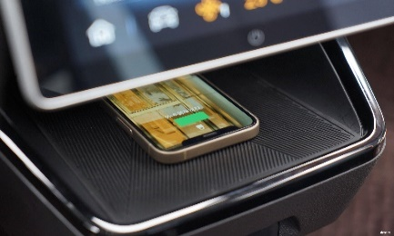
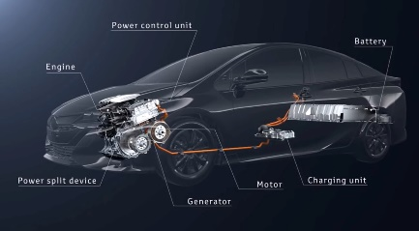
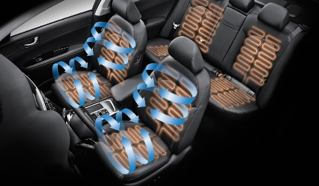
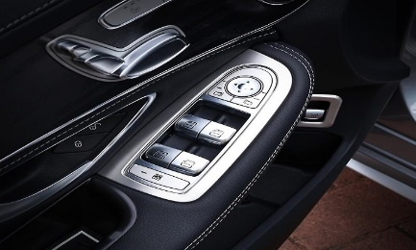
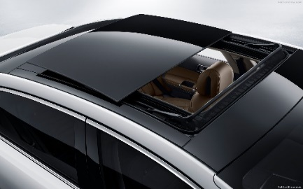
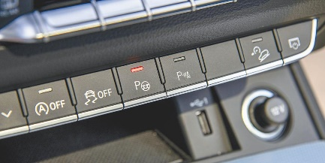
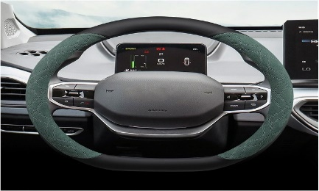
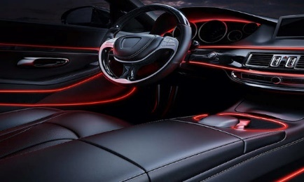


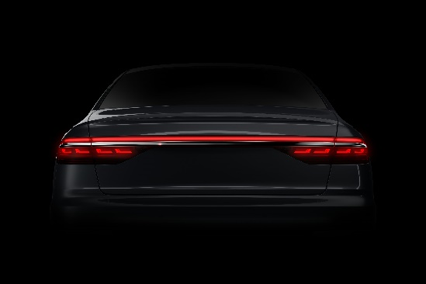
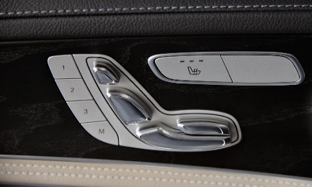












Application Field – Automotive
Wireless charging
OBC、ACDC
Seat ventilation/heating, Lumbar support massage
Window combination switch
Sunroof controller
Panel switch
Steering wheel combination switch
Shift lever
Interior ambient light
NFC digital key
Foot-kick sensor
Rear combination taillight
Seat adjustment switch
Central control touch switch
Touch reading light
Window lift, anti-clip
Air conditioning controller, switch
Rotary screen motor controller
PM2.5 sensor, Fragrance system
Power tailgate controller
Touch, power door handles
Tire pressure monitoring
Flip screen motor controller
Thermal Management System PTC
Combined instrumentation

Slide 28


















Major Customers in Automotive (Tier1)

Slide 29























Automotive Partner (OEMs)

Slide 30

Automative MCU Roadmap
Flash(KB)
ASILD
Developing
Sample
Mass Production
FM33H7xxA Series
Cortex-M7/R5, 240MHz, Grade1
Upto 4096K FLASH, 512K RAM
100/144/176Pin
12Bit Dual SAR ADC, DAC
CANFD/SPI/IIC/USART
HSM
Ethernet/FlexRay
ASILB
FM33FP5xxA Series
ARM-China STAR, 160MHz, Grade1
Upto 2048K FLASH, 256K RAM
100/144/176Pin
12Bit Dual SAR ADC,DAC
CANFD/LIN/SPI/IIC/USART
HSM
1024
ASILB
FM33FG5xxA Series
ARM-China STAR, 120MHz, Grade1
Upto 1024K FLASH, 128K RAM
64/100/144Pin
12Bit Dual SAR ADC, DAC
CANFD/LIN/SPI/IIC/USART
HSM
512
ASILB
FM33FG0xxA Series
Cortex-M0, 64MHz, Grade1
Upto 512K FLASH, 64K RAM
48/64/100/144Pin
12Bit SAR ADC, COMP, DAC
CANFD/LIN/SPI/IIC/USART /SENT
SFU
256
FM33LG0xxA Series
Cortex-M0, 64MHz, Grade2
Upto 256K FLASH, 32K RAM
32/48/64/80Pin
12Bit SAR ADC, COMP, OPA, 12Bit DAC
CAN/LIN/SPI/IIC/USART
ASILB
FM33HG0xxA Series
Cortex-M0, 64MHz, Grade1
Upto 256K FLASH, 32K RAM,
8K DATAFLASH
32/48/64/80Pin
SAR ADC, COMP, OPA, DAC
CANFD/LIN/SPI/IIC/USART
HSM
128
FM33LE0xxA Series
Cortex-M0, 64MHz, Grade1
Upto 128K FLASH, 16K RAM
32/48Pin ,12Bit SAR ADC
LIN/SPI/IIC/USART
时间
2021
2022
2023
2024
2025

Slide 31
Automative Specific MCU Roadmap
Flash(KB)
Developing
Sample
Mass Production
512
Smart Surface
Motor Control/Actuator
FM33FT0xxA Series
Cortex-M0, 48MHz, Grade1
Upto 384K FLASH, 32K RAM
32/64/100Pin, 12Bit SAR ADC
CAN/LIN/SPI/IIC/USART
TSI (14CH) Self Capacitance
ASILB
FM33HT0xxA Series
Cortex-M0, 64MHz, Grade1
Upto 384K FLASH, 32K RAM
8K DATAFLASH
48/64/100Pin CANFD/LIN/SENT
TSI (36CH) Self&Mutual Capacitance
ASILB
256
FM36LV0xxA(S) Series
Cortex-M0, 64MHz, Grade1
upto256K FLASH, 16K RAM
32/48Pin, CAN, LDO, LINPHY
12Bit SAR ADC
SPI/IIC/USART
FM36FQ5xxA Series
ARM-China STAR, 120MHz, Grade1
upto256K FLASH, 16K RAM, 16KDataFlash
32/48/64Pin, LDO, LINPHY
12Bit SAR ADC, 10Bit DAC
SPI/IIC/USART/CANFD
Predriver
128
ASILB
FM33CT0xxA Series
Cortex-M0, 48MHz, Grade1
Upto 128K FLASH, 16K RAM
20/32/48Pin
LIN
TSI (20CH) Self&Mutual Capacitance
FM36LH0xxA Series
Cortex-M0, 64MHz, Grade1
upto128K FLASH, 16K RAM
32/48Pin, LDO, LINPHY
12Bit SAR ADC, SPI/IIC/USART
Predriver
FM36LD0xxA Series
Cortex-M0, 64MHz, Grade1
upto128K FLASH, 8K RAM, 4KDataFlash
32/48Pin, LDO, LINPHY
12Bit SAR ADC, 10Bit DAC
OPA/ACMP
SPI/IIC/USART/CANFD
Predriver
Lighting
64
FM36VT0xxA Series
Cortex-M0, 48MHz, Grade1
Upto 64K FLASH, 8K RAM
20/32/48Pin, LDO, LINPHY
TSI (8CH) Self&Mutual Capacitance
FM36LL0xxA Series
Cortex-M0, 64MHz, Grade1
upto48K FLASH, 8K RAM
20Pin, LDO, LINPHY
12Bit SAR ADC
LIN/SPI/IIC/USART
RGB Driver
FM33LF0xxA Series
Cortex-M0, 64MHz, Grade1
Up to 64K FLASH, 8K RAM
32/48Pin
2xOPA, 4xCOMP
12bit SAR ADC, 10bit DAC
LIN/SPI/IIC/USART

Slide 32
Application Field - Industrial
Industrial Automation
Industrial Motor
PLC, Inverter, Servo drive, Encoder, IO-LINK, all kinds of industrial master control board
01
02
Linear drives, pumps, valves, medical motors, industrial tools, elevator motors
Industrial Control
Sensing and Instrumentation
04
03
Power and Energy
Sensor module, transmitter, all kinds of testing instrument, medical instrument, fire instrument
Digital power supply, Portable power supply, UPS, Generator, PV, Energy storage, Charging pile

Slide 33




















































































Key customers in Industrial field
海菱智慧

Slide 34










Application Field – Industrial
Industrial Automation
Factory Automation
Elevator control
Industrial robots
Industrial robots
Elevator external call board (lamination board)
Inside call board
Elevator car top control panel
Textile Machinery
Welding machine and mask
Textile machine
Sewing machine
Digital welder
Digital welder
Automatic dimming mask

Slide 35
















Application Field – Industrial
Power and Energy
Industrial Motor
Industrial power supply
Medical instruments
Emergency power
charger
Inverter
Portable power supply
Power wheelchair
ventilator / respirator
Energy Storage
Industrial tools
Cement mixer
Vacuum pump
Fan
Home energy storage
Linear drive
Industrial and commercial energy storage
Base station backup power
Industrial and commercial energy storage
Electric bed
Height-adjustable table

Slide 36


















Application Field – Industrial
Sensor and Instrument
Industrial field measuring instruments
Safety meter
Temperature and humidity meter
Pressure meter
Flow meter
Level meter
Composition analysis meter
Safety shed
Isolator
Industrial field actuators
Special measuring instruments
Electric valve positioner
Temperature controlled valve
Laser gas measurement
Electromagnetic radiometer
Photoelectric sensors
Anemometer
Display recording instrument
Medical testing meter
paper-display instrument
paperless display instrument
Glucose meter
Blood Pressure Monitor
Frontal temperature gun

Slide 37
Industrial MCU Roadmap
Flash(KB)
Developing
Sample
Mass Production
FM33FRVxx Series
ARM-China STAR, 240MHz
Upto 1M FLASH, 256K RAM
Up to 144 Pin
CANFD/ECAT
512
FM33LP5xx Series
ARM-China STAR, 240MHz
Upto 512K FLASH, 128K RAM
Up to 100 Pin
EPWM, CANFD,EXMC
FM33FS5xx Series
ARM-China STAR, 120MHz
Upto 512K FLASH, 96K RAM
Up to 144 Pin
CANFD/EXMC
FM33A0xxE Series
Cortex-M0, 48MHz
Upto 512K FLASH, 80K RAM
48/64/80/100Pin
384
FM33FR0xx Series
Cortex-M0, 48MHzUpto 384K FLASH, 32K RAM
32/64/100Pin, 12Bit SAR ADC
CAN/LIN/SPI/IIC/USART/TSI
FM33FH0xx Series
Cortex-M0, 72MHz
Upto 384K FLASH, 32K RAM
32/48/64/80/100Pin
12bit ADC, DAC
CAN/SENT/QSPI/I2C/USART/TSI
FM33LG0xx Series
Cortex-M0, 64MHz, Grade2
Upto 256K FLASH, 32K RAM
32/48/64/80Pin
12Bit SAR ADC, COMP, OPA, 12Bit DAC，VBAT
256
FM33FK5xx Series
ARM-China STAR, 80MHz
Upto 256K FLASH, 48K RAM
32/48/64/100
12Bit SAR ADC, COMP, DAC
CANFD/LIN/QSPI/IIC/USART /USB
FM33LX5xx Series
ARM-China STAR, 168MHz
Upto 256K FLASH, 48K RAM
Up to 100Pin
ADC, 3*Atimer
FM33LC0xx Series
Cortex-M0, 64MHz
Upto 256K FLASH, 24K RAM
32/48/64Pin
12Bit SAR ADC, OPA, USB
128
FM33LE0xx Series
Cortex-M0, 64MHz
Upto 128K FLASH, 16K RAM
32/48/64pin
FM33LR0xx Series
Cortex-M0, 64MHz
Upto 64K FLASH, 16K RAM
32/44/48Pin
12Bit SAR ADC
64
FM33LF0xx Series
Cortex-M0, 64MHz
Upto 64K FLASH, 16K RAM
32/48/64Pin
12Bit SAR ADC, DAC, OPA,COMP
时间
2019
2023
2024
2025

Slide 38

























Application Field – Smart Connectivity for Fire Protection & Home
01
02
  Security
Smart Applications
PA
R
T
NE
R
Focused on the fields of smart security and fire protection
Mainly used in various alarms and low-power IPC product applications
Modern smart home product applications, smart door locks, smart toilets, electric curtains, cleaning products, etc.
03
Smart Connectivity
Solutions based on MCU's low-power consumption to wide-area IoT: LoRa WAN, Sigfox, W-MBus, etc.
Low-Power IPC
Smart Toilet
Smart
Door lock
Gas Alarm
Fire Alarm
Temperature sensing
Fire Alarm
carbon monoxide Alarm

Slide 39






Wide Area Low Power IoT solution
Provide a complete set of solutions, including reference design, and networking methods, LoRa, LoRa WAN, Sigfox, W-Mbus

Slide 40
Fire Protection & Home MCU Roadmap
Flash(KB)
developing
FM33H7xxA Series
Cortex-M7/R5, 240MHz, Grade1
Upto 4096K FLASH, 512K RAM
100/144/176Pin
12Bit Dual SAR ADC, DAC
CANFD/SPI/IIC/USART
HSM
Ethernet/FlexRay
mass production
FM33FP5xxA Series
ARM-China STAR, 160MHz, Grade1
Upto 2048K FLASH, 256K RAM
100/144/176Pin
12Bit Dual SAR ADC,DAC
CANFD/LIN/SPI/IIC/USART
HSM
1024
sample
FM33FG5xx Series
ARM-China STAR, 120MHz, Upto 1024K FLASH, 128K RAM
64/100/144Pin
12Bit Dual SAR ADC, DAC
CANFD/LIN/SPI/IIC/USART
FM33A0xxE Series
Cortex-M0, 48MHz
Upto 512K FLASH, 80K RAM
48/64/80/100Pin
512
FM33FG0xx Series
Cortex-M0, 64MHz
Upto 512K FLASH, 64K RAM
48/64/100/144Pin
12Bit SAR ADC, COMP, DAC
CANFD/LIN/SPI/IIC/USART /SENT
FM33LG0xx Series
Cortex-M0, 64MHz, Grade2
Upto 256K FLASH, 32K RAM
32/48/64/80Pin
12Bit SAR ADC, COMP, OPA, 12Bit DAC
256
FM33FR0xx Series
Cortex-M0, 48MHzUpto 384K FLASH, 32K RAM
32/64/100Pin, 12Bit SAR ADC
CAN/LIN/SPI/IIC/USART/TSI
FM33LC0xx Series
Cortex-M0, 64MHz
Upto 256K FLASH, 24K RAM
32/48/64Pin
12Bit SAR ADC, OPA, USB
FM33FK5xx Series
ARM-China STAR , 80MHz
Upto 256K FLASH, 48K RAM
32/48/64/100
12Bit SAR ADC, COMP, DAC
CANFD/LIN/QSPI/IIC/USART /USB
128
FM33LE0xx Series
Cortex-M0, 64MHz
Upto 128K FLASH, 16K RAM
32/48/64pin
FM33LF0xx Series
Cortex-M0, 64MHz
Upto 64K FLASH, 16K RAM
32/48/64Pin ,12Bit SAR ADC
DAC, OPA,COMP
FM33LR0xx Series
Cortex-M0, 64MHz
Upto 64K FLASH, 16K RAM
32/44/48Pin ,12Bit SAR ADC
时间
~2022
2023
2024
2025

Slide 41
Platform Advantages
Competitive Advantages
Technology leadership
Considerate services
Complete layout
Stable supply
Low power performance
Reliability accumulation
Superior equivalent kernel performance
64KB~1MB FLASH
Package covers 24 to 144 pins
Rich peripheral interface resources such as USB, CAN, etc
Support for multiple security encryption and decryption engines
Domestic + International Dual-supply Guarantee
Long-term cooperation basis
Grasp the industry dynamics
Excellent quality control
One to one technical service
Responsive

Slide 42













MCU Eco-System
Application documentation
Support common development environment
MFANG Graphical code generator
Original factory supporting programmer
Drivers and routines
Evaluation board
Technical support
Solutions
Programming tool
Support for third-party ARM emulators
J-Link / U-Link
MCU Development Board
Developer Forum
Integrated development environment
Software tools
Rich routine library
At present, the programmer has been matched with a drag one and a drag eight, batch applied to the client
The third party has also been compatible with Hilt and other manufacturers
In addition to the current common kei and IAR, the compiler environment has also been compatible with open source Eclipse development
Mfang2.0, visual programming greatly improves the R&D efficiency of the client
With the continuous upgrading of devices in the Internet of things, there are operating system requirements, and it has been adapted to LiteOS, OneOS, FreeRTOS, RTThread and other micro-operating systems
According to the needs of different clients to develop a complete reference process;
At the same time, also for the industry needs to provide customers with the corresponding algorithm library

Slide 43




MCU Toolchain
Minimum system board
Off-line programmer
Graphical configuration interface
Chip programming fixture
Production configuration
upper computer
Multi-function programmer

Slide 44


Developer Forum & MFANG
Complete application routines for various family products
Q&A manuals commonly encountered by developers
Update the various resources needed by developers regularly
MFANG is a free development tool launched by Fudan Micro for the convenience of developers, including hardware instructions, referral function allocation, bottom driver generation and other functions, and the graphical configuration interface allows users to easily configure chip peripheral pins and functions.
Main function module
application notes
Answers developers' questions online in real time
Forum: www.fmdevelopers.com.cn
MFANG：mfang2.fmdevelopers.com.cn

Slide 45









Automotive MCU Development Eco-System Services
    Support IDE: Keil、IAR、Eclipse、MFANG
    Support Chain
MCAL Configuration Tool
LIN Stack Configuration Tool
MCAL
BSW
Simulink
Evaluation Kit
    Comply with AUTOSAR Specifications：MCAL
    Basic software docking: HiRain, Neusoft Reach, Elektrobit

Slide 46

MCU Touching Development Eco-System Services
    Touch debugging host computer

Slide 47
COOPERATE CULTURE

Slide 48

Culture
TRUST
RESPECT
HONEST
CREDIT
PASSION
INNOVATION
LEADING
EXCELLENCE

Slide 49

Vision
Fudan Microelectronics Group is willing to work with partners and end users to create a better future!
Fudan Microelectronics Group always insists on independent product development, selects the most advanced production lines and production processes to produce products, adheres to the most stringent quality management system and process, and attaches importance to the use and protection of intellectual property rights to ensure that it provides users with high-quality, high-safety, complete varieties and industry-leading products.

Slide 50

WE USE CHIPS SERVICE
PROVIDE YOU WITH STRONG TECHNICAL SUPPORT
be your strong technical support
anytime anywhere

